Slide 1
CATS
(Constructing Algorithmic
Trading Structures)
Alexis Porter Benjamin Liu Daniel Wang
Notes:
Ben

Slide 2



Meet Our Team
Alexis Porter
Graduate Student
Psychology Dept
Masters in Statistics
Benjamin Liu
2nd Year Undergraduate
MMSS
Statistics
Daniel Wang
3rd Year Undergraduate
Computer Science
Statistics
Notes:
All 3

Slide 3
Outline
Background
&
Overview
Project Pipeline
Algorithmic Trading
Review
&
Conclusion
Notes:
Alexis

Slide 4


Background
Investment strategies vary in complexity
Real-time market book data enables financial predictions with high temporal specificity
However direct streams of real-time data requires customized hardware and dedicated location space
Notes:
Alexis

Slide 5
Project Pipeline
Data Collection
Data Processing
Algorithmic Trading
Using Server Sent Events to collect ongoing level 2 data from alternative cloud platforms
Using in house functions to standardize level 1 and level 2 data prior to implementing computational models
Using processed data to run computational predictive models XGboost
Notes:
Alexis

Slide 6
Data Types
Level 1 Market Data
Level 2 Market Data
What’s the difference?
How are both types of data obtained?
Notes:
Ben

Slide 7
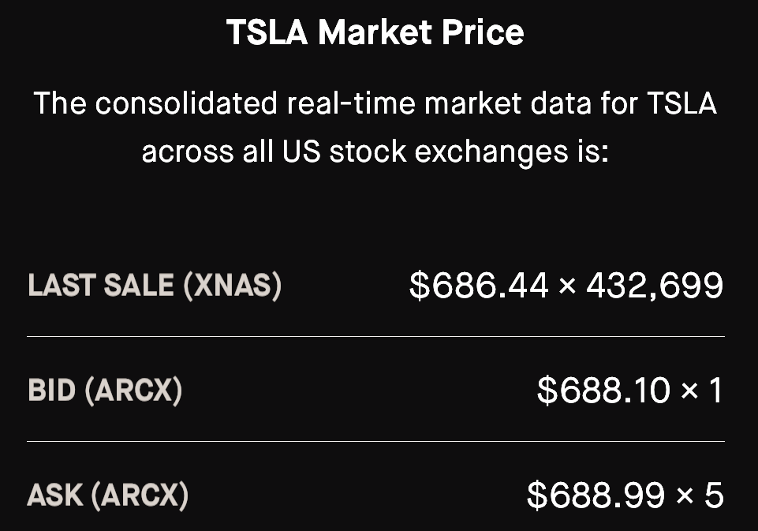
Level 1 Market Data
Quantities
Prices
Notes:
Ben

Slide 8
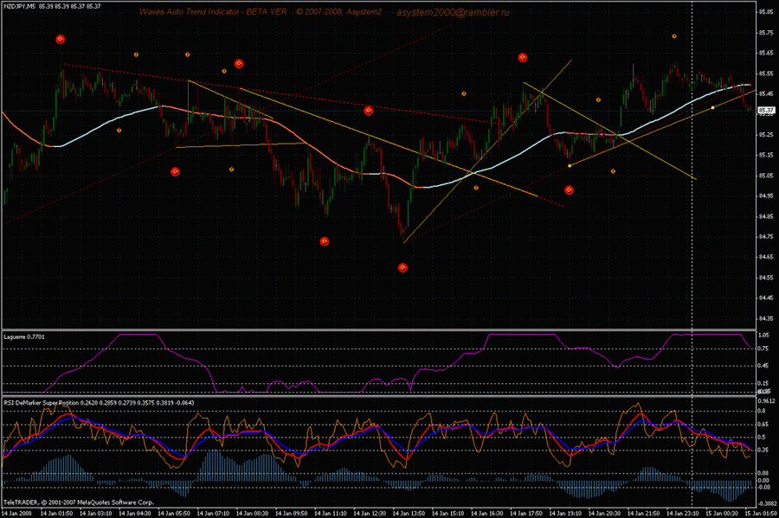
Level 1 Market Data
Notes:
Ben

Slide 9
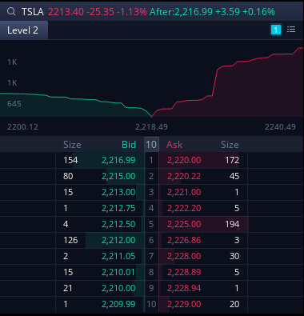
Level 2 Market Data
Notes:
Ben

Slide 10
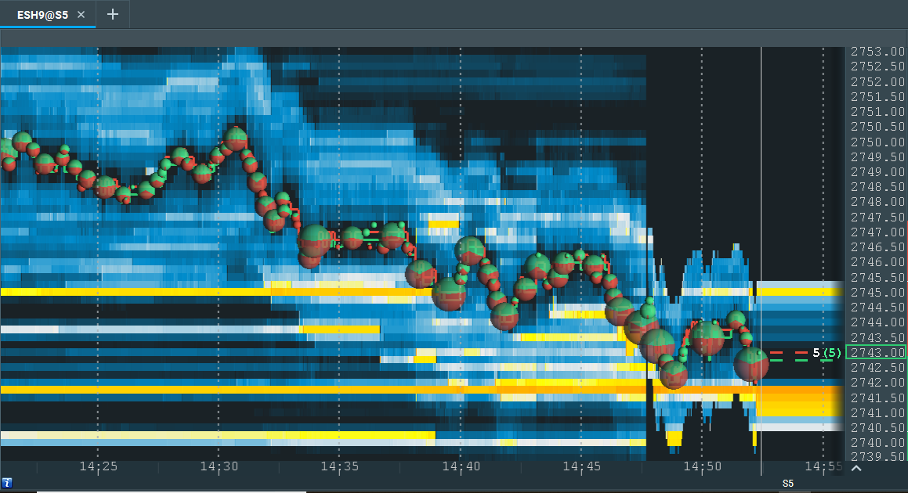
Level 2 Market Data
Notes:
Ben

Slide 11
Feature Engineering
When is the best time to buy or sell stocks?
MACD
BB
Moving Average
Convergence Divergence
Bollinger Band
RSI
EMA
Relative Strength Index
Exponential Moving Average
Notes:
Ben

Slide 12
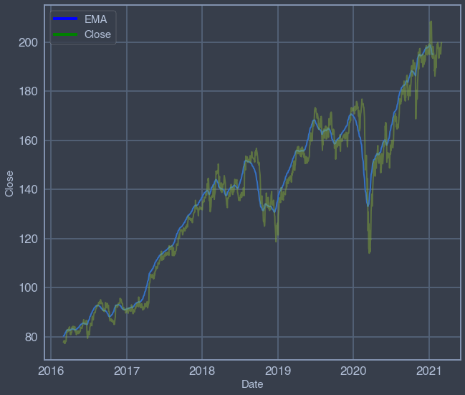
Exponential Moving Average
Notes:
Alexis

Slide 13
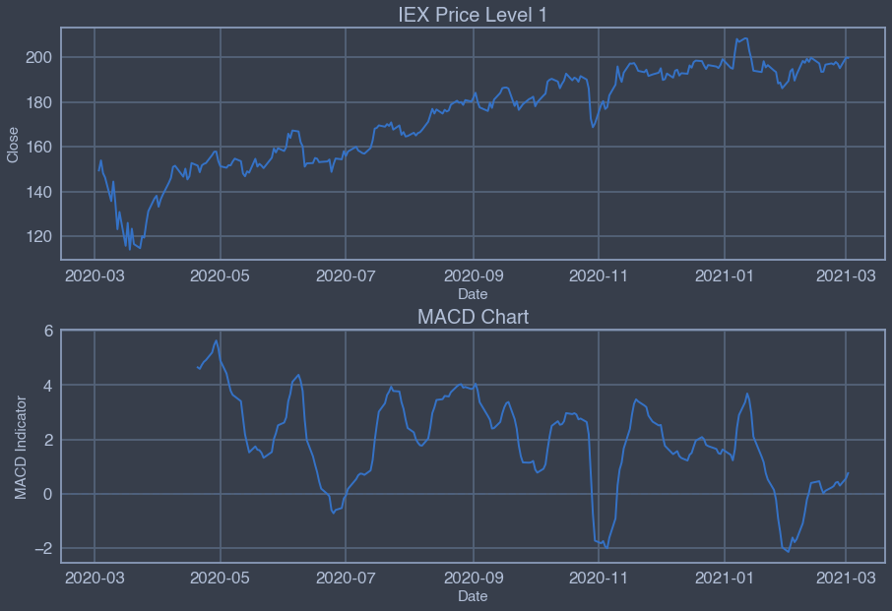
MACD
Notes:
Ben

Slide 14
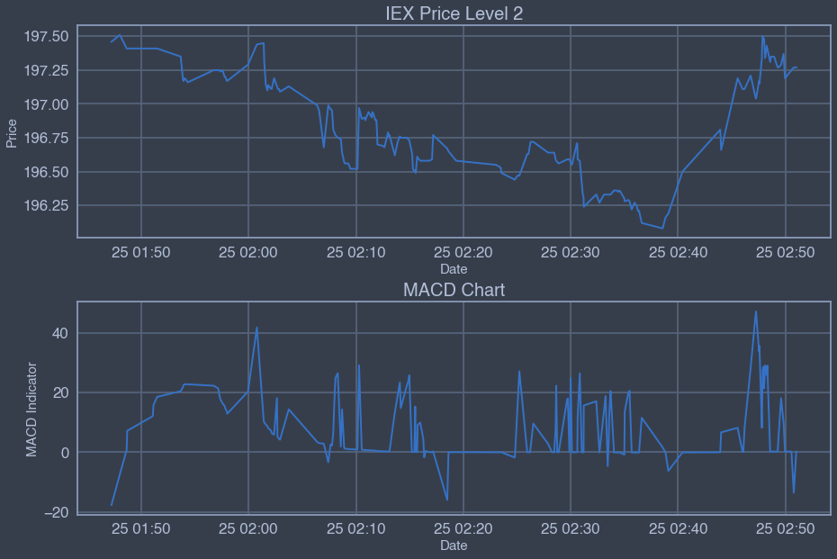
MACD
Notes:
Ben

Slide 15
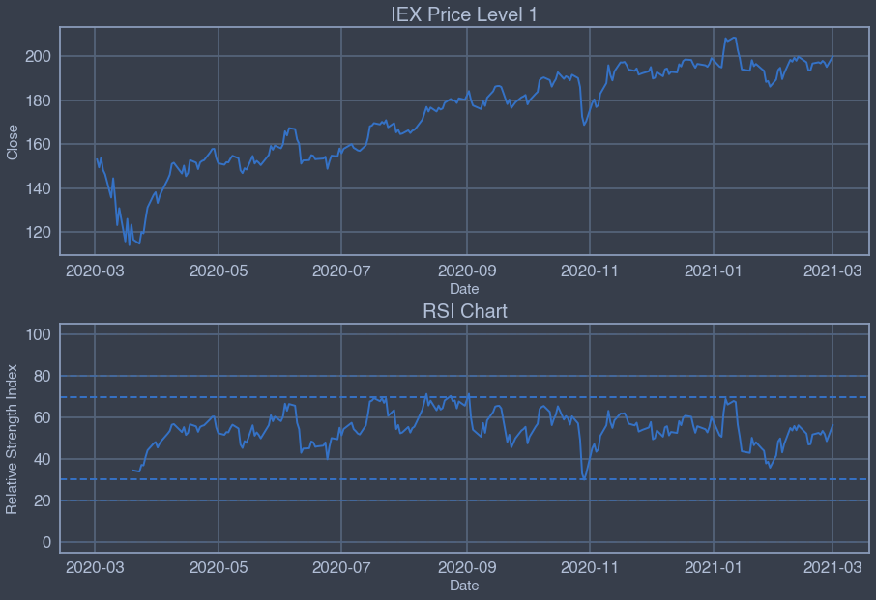
Relative Strength Index
Overvalued
Undervalued
Notes:
Alexis

Slide 16
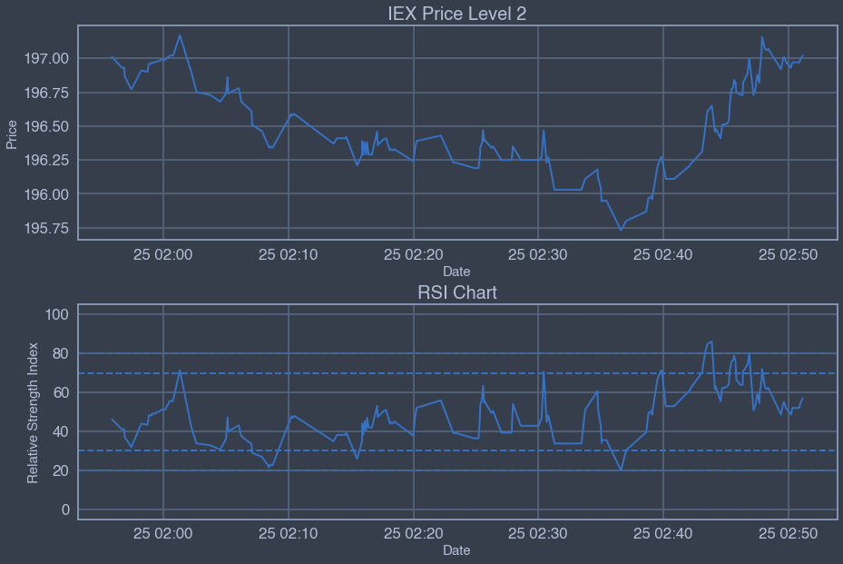
Relative Strength Index
Sell
Buy
Notes:
Alexis

Slide 17
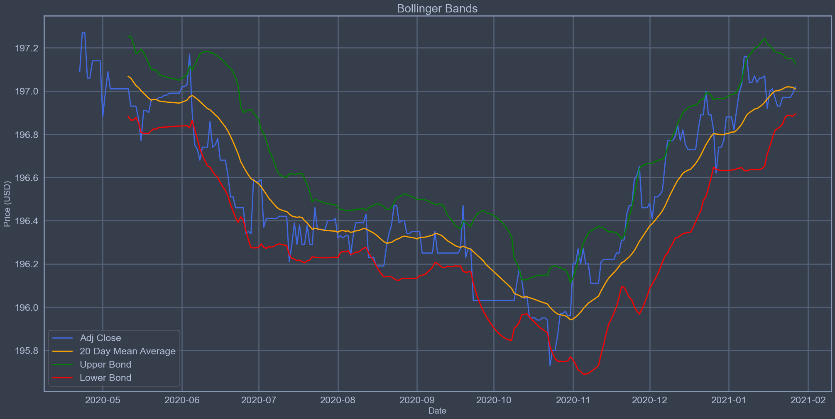
Bollinger Band
Notes:
Daniel

Slide 18
Bollinger Band
High Volatility
Low Volatility
Notes:
Daniel

Slide 19
Bollinger Band
Notes:
Daniel

Slide 20

What is Qlib?
Notes:
Ben

Slide 21
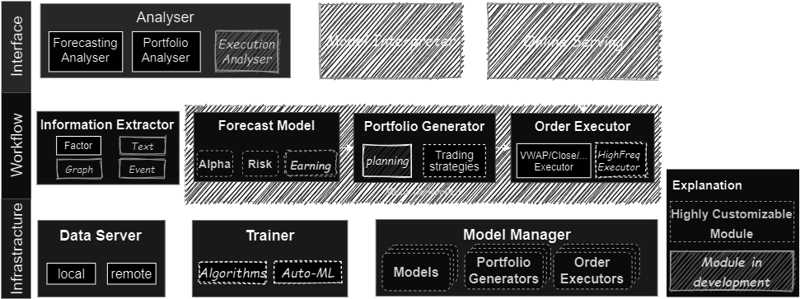
Qlib Framework
Notes:
Ben

Slide 22
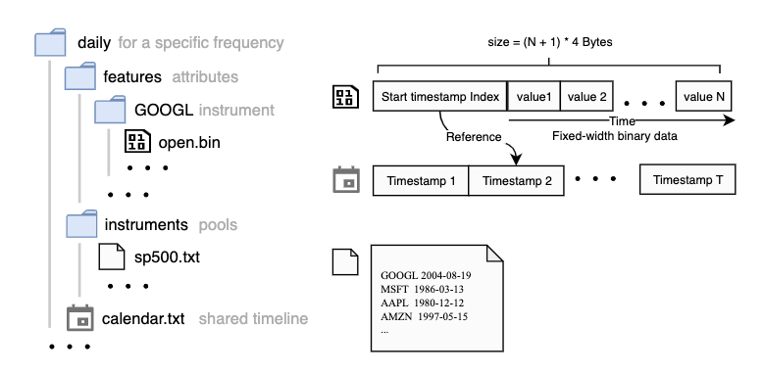
Useful Features of Qlib
Notes:
Ben

Slide 23
Our Framework
Modeling
External Data Sources
Data Input
Data Processing
Indicators/Features Extraction
Notes:
Ben

Slide 24



Data Allocation
Retrieve new data
SSE
Check website for updates
Notes:
Alexis

Slide 25
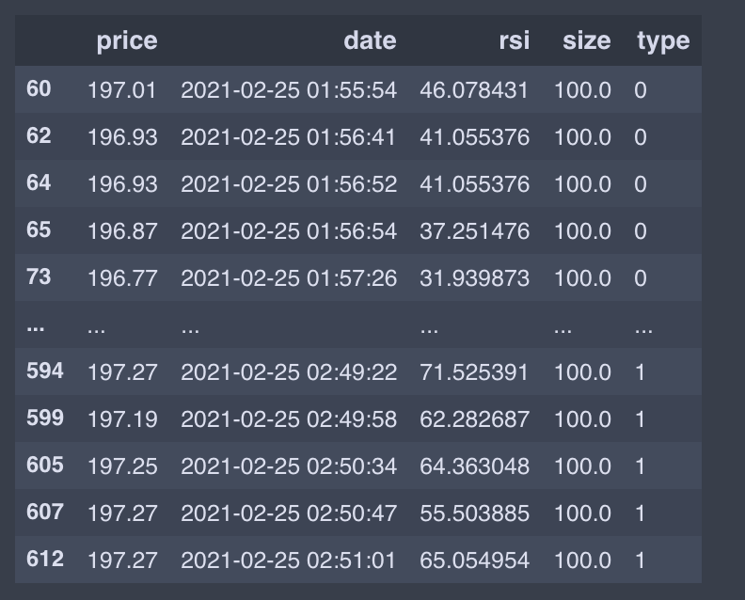

Data Processing
Tidy Data
Noisy Data
Processor
Abstract Class
class Processor(Serializable):
def fit(self,df):
Child Class
class FormatLevelTwo(Processor):
def __call__(self,df):
output={}
Notes:
Alexis

Slide 26
Our Data
IEX Level 1 Data, past year
Collected using free API service
IEX Level 2 Data, 1 hour
Collected using limited SSE, premium IEX subscription
Notes:
Alexis

Slide 27

Model
Notes:
Daniel

Slide 28
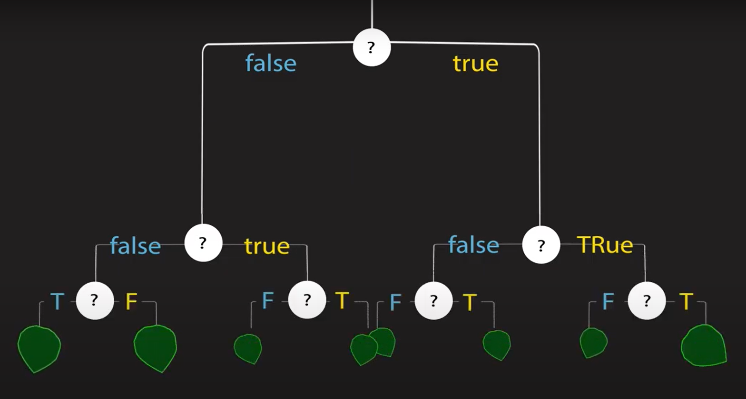
Model - Decision tree
Notes:
Daniel

Slide 29



Model - Boosting
Random samples
Models
Original data
Weighted samples
Weighted results
Notes:
Daniel
Method of combining many weak learners (trees) into a strong classifier in a iterative fashion

Slide 30

Model - Gradient Boosting
Random samples
Models
Original data
Residuals
Result
Notes:
Daniel
Use gradient descent to create new learners
Each tree attempts to minimize the errors of previous tree
“(A Gradient Boosting) that is developed with both deep consideration in terms of systems optimization and principles in machine learning”

Slide 31
Train, Validate and Test
Full data
Test split
Validate split
80%
Training
80%
20%
20%
Validation
Testing
Testing
Notes:
Daniel

Slide 32



Custom Model Integration
Technical indicators
MACD
RSI
Train
Validate
Test
2020-01-01
2020-11-31
2020-11-31
2021-01-15
2021-01-19
2021-03-04
Notes:
Ben

Slide 33
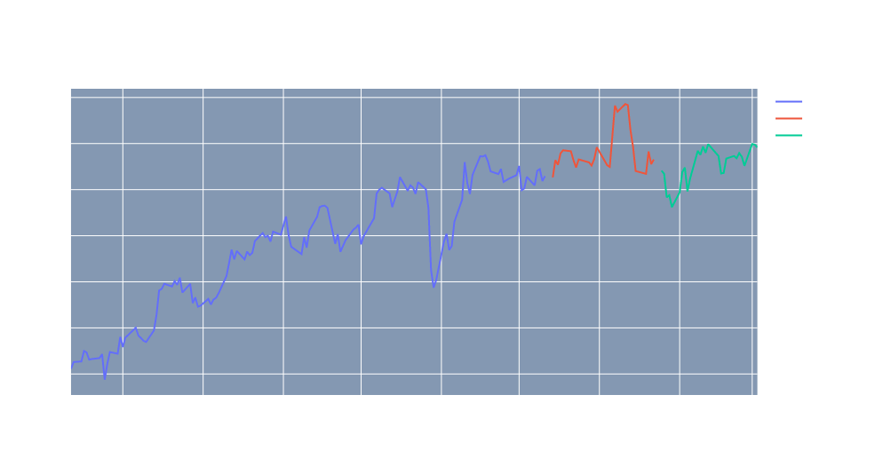
Level 1 IEX Data Model
Notes:
Ben

Slide 34
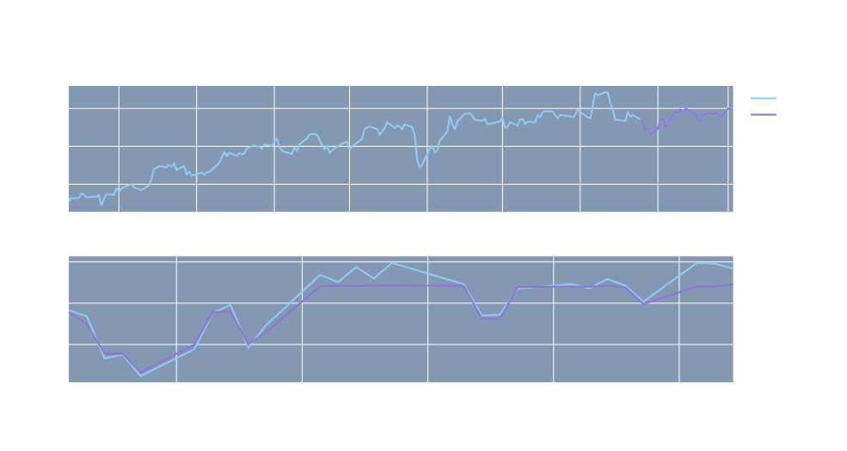
IEX Level 1 Data Model
Notes:
Ben

Slide 35
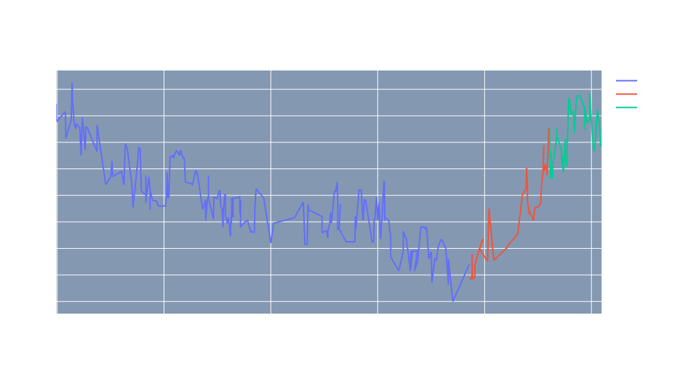
IEX Level 2 Data Model
Notes:
Ben

Slide 36
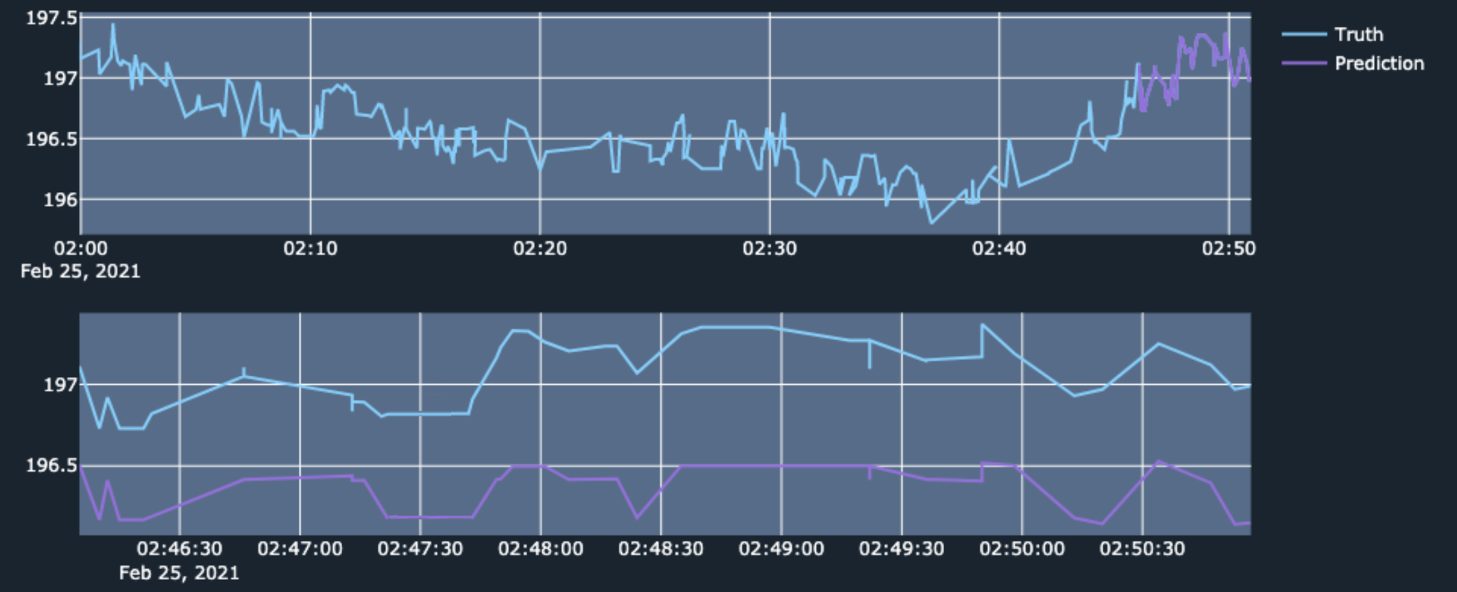
IEX Level 2 Data Model
Notes:
Ben

Slide 37
Review
External data source
Data types and their differences
Information different data type contains
Data allocation & processing
Data retrieval methods
Data cleaning
Features
Data types and their differences
Information different data type contains
Model and algorithm
XGBoost
Decision tree and boosting
Qlib
What is Qlib
Similarities and differences
Algorithmic trading
Model integration
Results
Framework
Components of our framework
Connections between components
Notes:
Daniel

Slide 38
Limitations and future developments
Data retrieval
Notes:
Daniel

Slide 39
Limitations and future developments
ERROR!
Memory Full
Notes:
Daniel
manual data gathering
Storage 3 days multiple gigabyte

Slide 40
Limitations and future developments
Data retrieval
Online servers
Notes:
Daniel

Slide 41


Limitations and future developments
Notes:
Daniel

Slide 42
Limitations and future developments
Data retrieval
Online servers
User friendly interface
Notes:
Daniel

Slide 43

Limitations and future developments
Terminal
Graphical user interface
Notes:
Daniel

Slide 44
Limitations and future developments
Data retrieval
Online servers
User friendly interface
Automatic workflow and execute trading
Notes:
Daniel

Slide 45

Thank You
Checkout our github blog at github.com/aporter1350/cats.github.io

